Slide 1
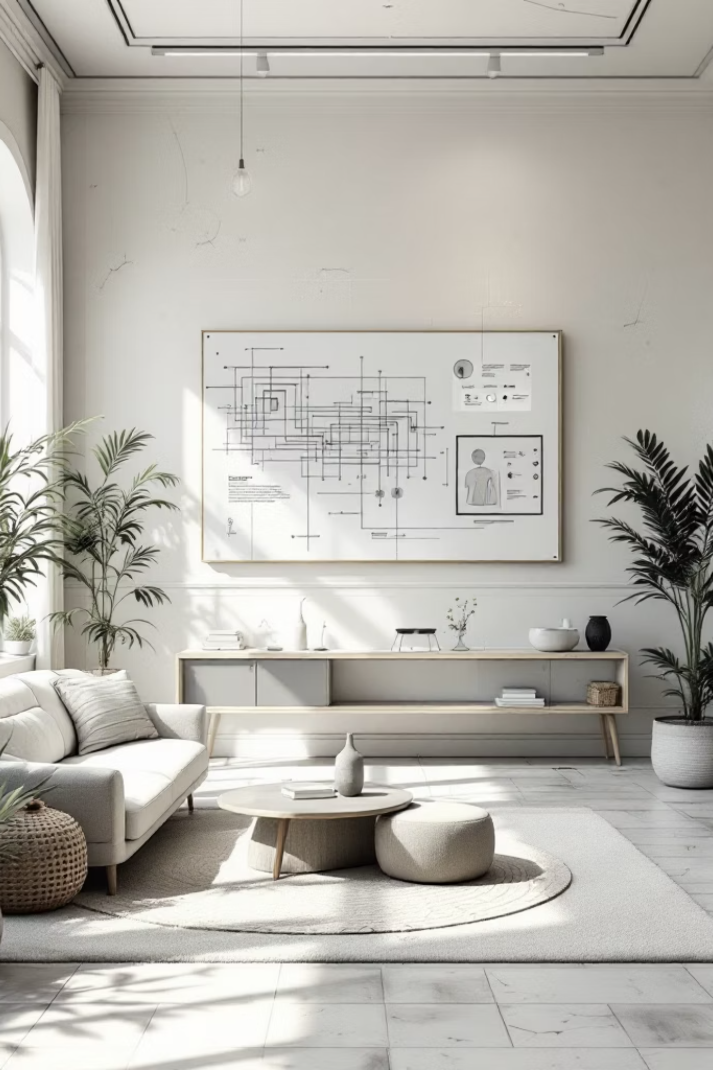
DecoreSpace
Reimagining Home Interiors with AI
Team: Moumitha, Lakshmi, Lavanya, Leena, Chandana
Siddhartha Education Academy Group of Institutions

Slide 2
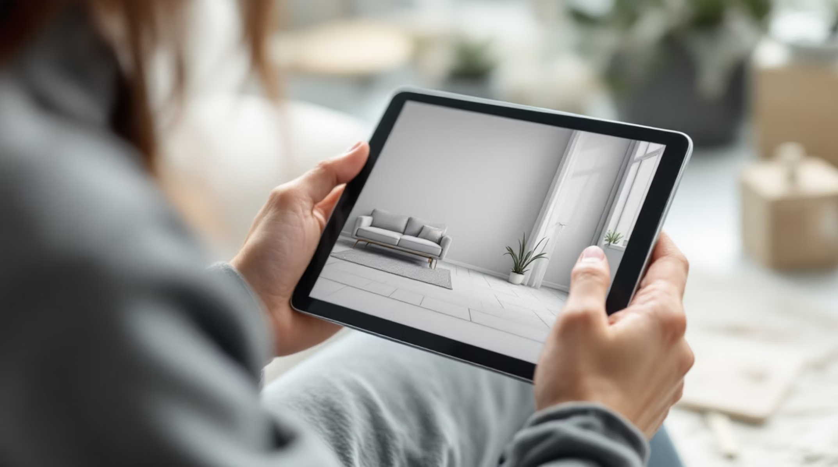
INNOVATION
AI-Powered Interior Design Revolution
Instant Design Transformations
Upload a room photo and receive AI-generated design variations instantly. DecoreSpace makes professional interior design accessible to everyone.
Upload room images effortlessly
Choose from multiple design styles
Get instant AI-generated visualizations
Make informed design decisions

Slide 3
Challenges in Traditional Interior Design
Time-Consuming Process
High Costs
Visualization Gap
Limited Personalization
Traditional design takes weeks of consultations, planning, and revisions
Professional design services remain expensive and inaccessible for budget-conscious users
Customers struggle to envision how different styles will transform their spaces
Designers face challenges understanding and delivering on unique customer preferences

Slide 4






SOLUTION
Introducing DecoreSpace
Upload Photo
Choose Style
Users capture their room
Select design preferences
AI Generates
Visualize & Decide
Instant redesigned images
Make confident choices

Slide 5
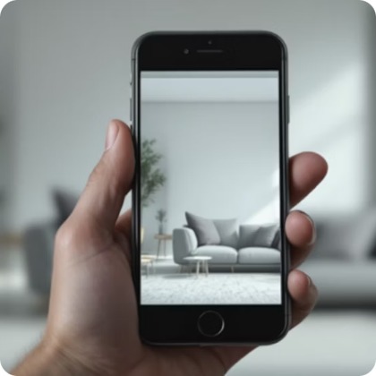
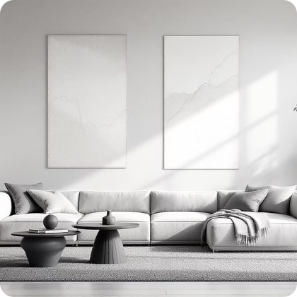

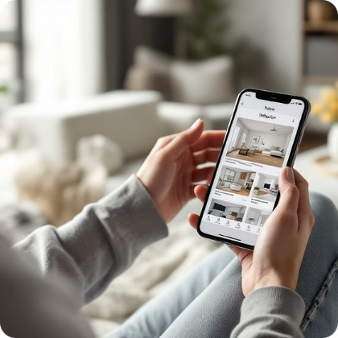
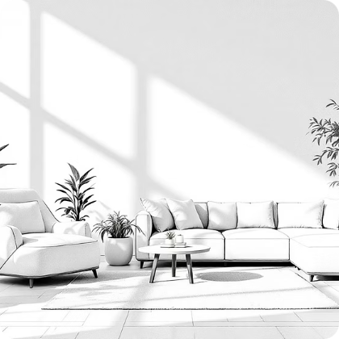

Key Features That Empower Users
Room Image Upload
Multiple Design Styles
AI Transformations
Save & Share
Simple, intuitive photo capture and upload functionality
Modern, Minimalist, Luxury, Scandinavian, and more options
Instant, high-quality redesigned room visualizations
Download designs or share with family and designers
Furniture Suggestions
Cloud-Based Speed
Integrated recommendations with seller partnerships
Rapid processing and results delivery from anywhere

Slide 6

System Architecture & Workflow
Seamless Pipeline
Our architecture ensures fast, reliable transformations from upload to final design.
Processing Time: Under 30 seconds for most room transformations
Upload
Preprocess
Style Select
AI Generate
Postprocess
Quality: High-resolution output suitable for decision-making

Slide 7
Technology Stack Powering DecoreSpace
Frontend & Prototype
Backend & Database
AI & ML Models
Deployment & Processing
Lovable for rapid UI development
Bolt.new for prototyping
Gamma for presentations
Base44 for storage
Firebase for real-time data
PostgreSQL for scalability
Diffusion Models and GANs
RoomGPT / DecorAI API integration
Python, PyTorch, TensorFlow
HuggingFace / AWS / Vercel hosting
OpenCV for image preprocessing
Cloud-based scalable infrastructure

Slide 8
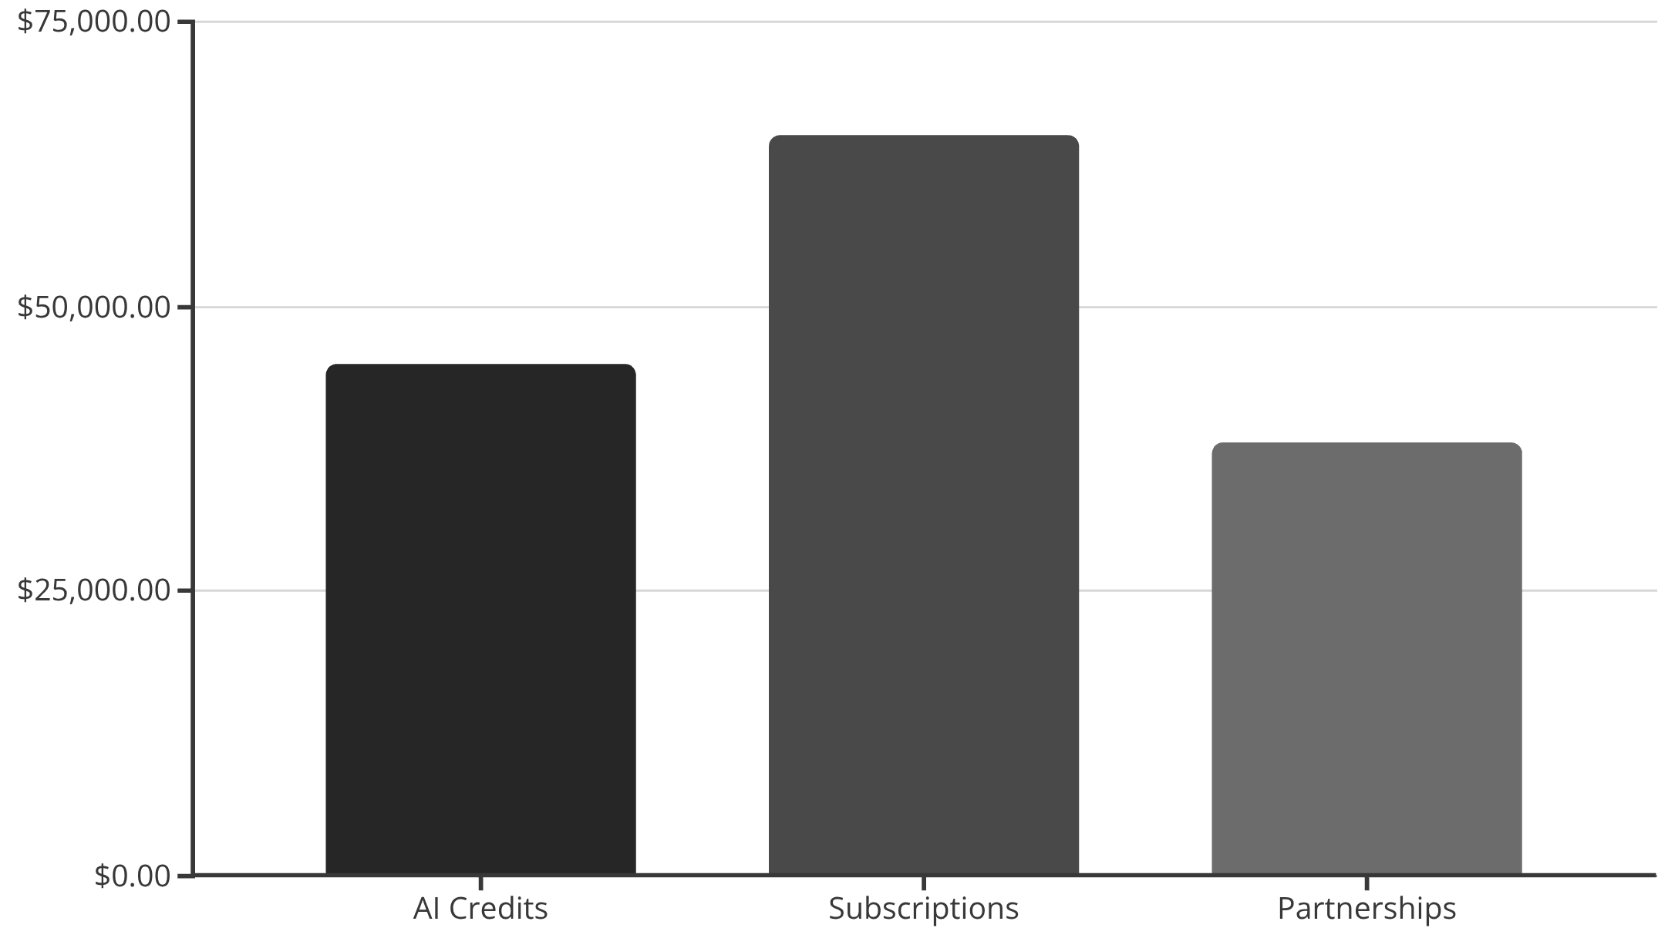
Market Scope & Business Opportunities
Growing Global Market
The AI interior design industry is experiencing rapid expansion, offering significant scalability and affordability advantages.
Target Audiences
Homeowners: Visualize dream spaces
Interior Designers: Pitch ideas faster
Real Estate Agents: Stage properties virtually
Furniture Sellers: Showcase products in context

Slide 9
FUTURE VISION
Planned Enhancements & Roadmap
Full 3D Visualization
1
Immersive room walkthroughs
2
AI Cost Estimation
Budget planning intelligence
AR Integration
3
View designs in real rooms
4
Personal Recommendations
Learning user preferences
Multi-Room Planning
5
Whole-home design coordination
6
Custom ML Model
Enhanced accuracy and precision

Slide 10

Thank You
Fast & Affordable
Informed Decisions
DecoreSpace delivers professional design solutions accessible to everyone
Empowering users to visualize and choose with confidence
AI in Creativity
Demonstrating Machine Learning's transformative power in design industries
Questions & Answers
We welcome your thoughts and inquiries about DecoreSpace

